Slide 1
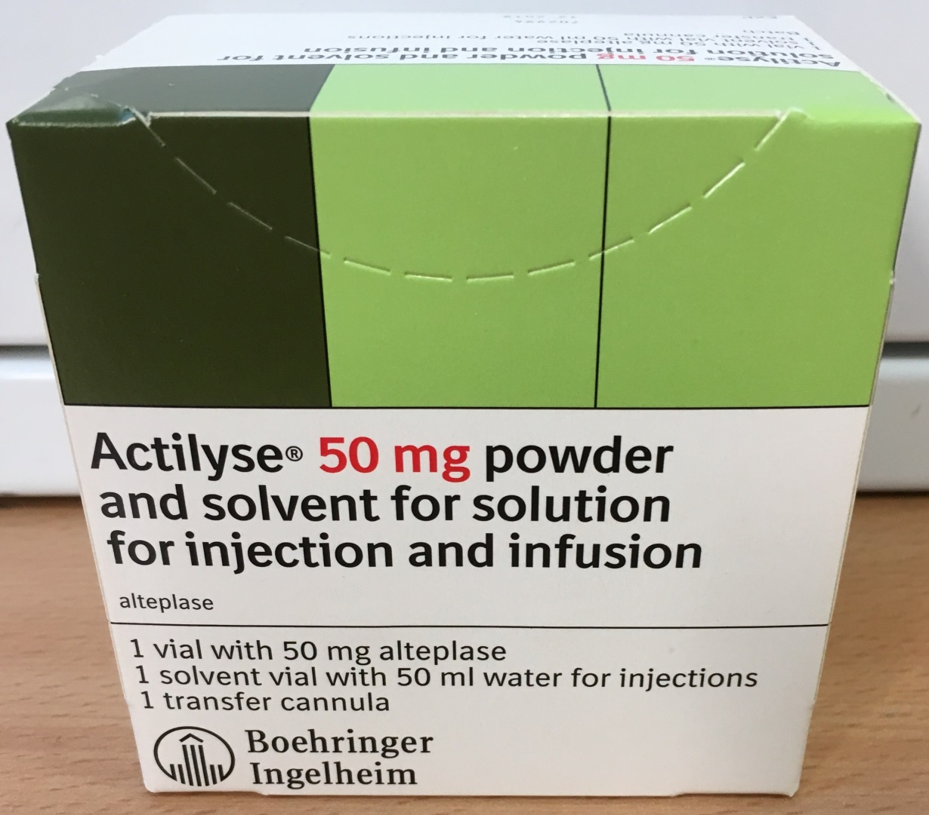
Alteplase 50 mg
Resuscitation Service October 2017
For suspected or confirmed massive PE in cardiac arrest give
50 mg Alteplase IV bolus in 50 ml of water for injections
British Thoracic Society guidelines for the management of suspected acute pulmonary embolism (Thorax, 2003)
Alteplase 50 mg is kept at Whipps Cross Hospital in
ED Resus
Elizabeth ward - ground floor, Junction 12
AAU
ICU Ground Foor, Junction 11
Barts Health: Safe and compassionate care

