Slide 1
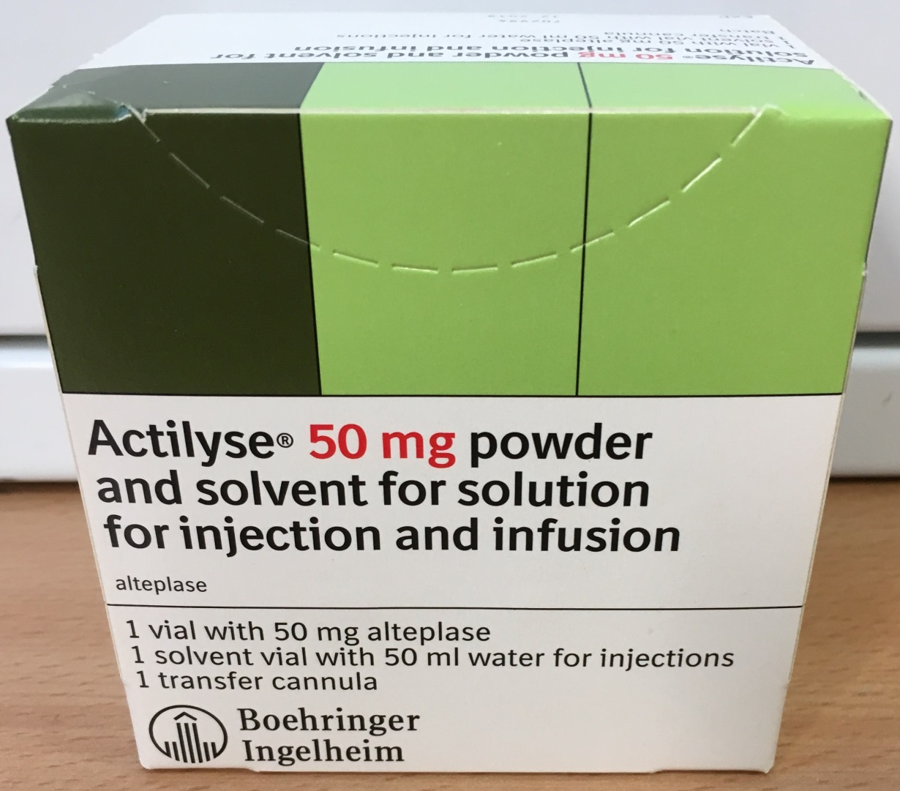
Alteplase 50 mg
Resuscitation Service October 2026
For suspected or confirmed massive PE in cardiac arrest give
50 mg Alteplase IV bolus in 50 ml of water for injections
British Thoracic Society guidelines for the management of suspected acute pulmonary embolism (Thorax, 2003)
Alteplase 50 mg is kept at Royal London Hospital in:
ED Resus & Zone A
ICU 4E/F
AAU 11E
Barts Health: Safe and compassionate care

